Slide 1
Percentage
Lecture: 5

Slide 2
Contains:
Calculation of percentage
Percentage Comparison
Percentage to Fraction conversion
Problem based on marks

Slide 3
Percentage: Per means divided and cent means 100.
To convert any value on the base of hundred.
Conversion of percentage to fraction: To convert percentage to fraction, divide that percent value by 100.
E.G. 50% = 50/100 = ½
25% = 25/100 = ¼
Conversion of fraction to percentage: To convert fraction to percentage multiply the fraction by 100.
For e.g. 3/8 = (3/8)*100 = 37.5 %

Slide 4
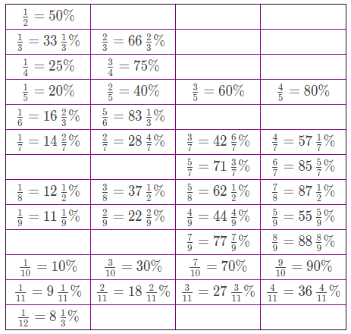

Slide 5
Let’s Practice.
Question : Find 55.55 % of 45.
Question : Find 45.45 % of 44

Slide 6
Conversion Percentage to Fraction
1. Convert 62.5% to a fraction.
2. Convert 28.56 % to a fraction.

Slide 7
3.Convert 130% to a fraction.
4. Convert 460% to a fraction.
5. Convert 133.33% to a fraction.

Slide 8
Q. If 16% of 40% of a number is 8, then find the number.
120
125
130
135

Slide 9
Q. What percentage of 2/7 is 1/35 ?
10%
20%
25%
none

Slide 10
Q. 16.66% of 300.
50
75
30
18.88

Slide 11
X % of Y = Y% of X
Question : Find 45% of 133.33
Answer : 45% of 133.33 = 133.33 % of 45
= (100+33.33)% of 45
= (1+1/3) * 45
= 4/3 * 45
= 60

Slide 12
Percentage Comparison
40 is what percentage of 60?
60 is how much percentage greater than 40?
40 is how much percentage lesser than 60?

Slide 13
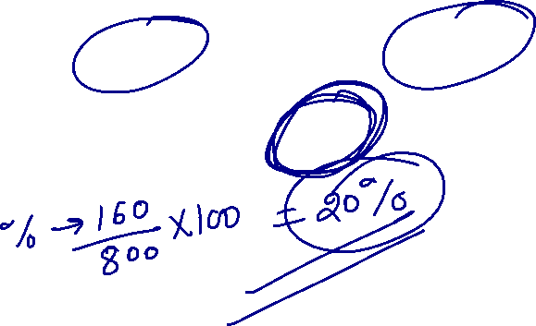
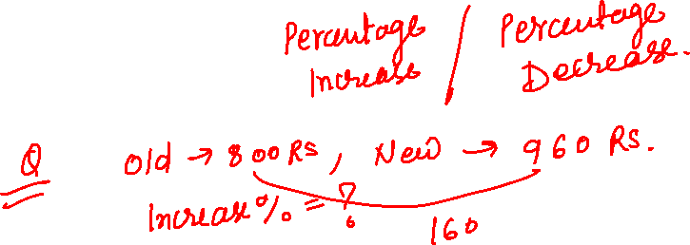

Slide 14
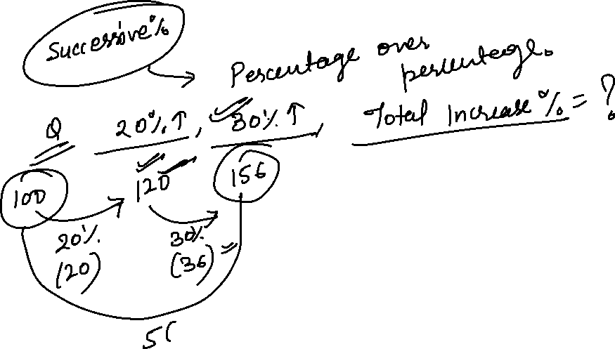

Slide 15
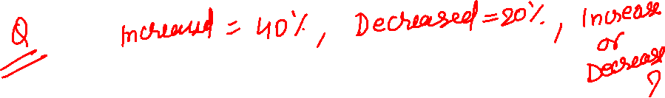

Slide 25
Question : If A’s salary is 20 % more than B, then by how much Percentage B’s salary is less than A.
20%
25%
16.66%
30%

Slide 26
Question : If A’s marks in an exam is 40 % less than B then by how much % B’s marks are more than A.
40 %
60 %
66.66 %
20 %

Slide 27
Question : If 16(2/3) % of a number is added to itself the number becomes 700. Find original number.
400
600
800
700

Slide 28
Question: A student multiplied a number by 3/5 instead of 5/3 What is the percentage error in the calculation? (a) 44% (b) 64% (c) 40% (d) 60%

Slide 29
Question: The number was being multiplied by 5/6. By mistake it is divided by 5/6. Find percentage error in result. (a) 44% (b) 64% (c) 40% (d) 60%

Slide 30
Problem based on Marks

Slide 31
Question : A student scored 140 Marks and still failed by 35 marks. If the passing criteria of that exam is 35%. Then find the maximum marks of that exam.
500
600
1000
700

Slide 32
Question : A student scored 25 % in an examination and still failed by 30 marks while another candidate scored 50% marks and get 20 marks more than the passing marks. Then find the passing percentage.
30 %
40 %
45 %
50 %

Slide 33
Question: In an Exam, 52% candidates failed in English, 42% in mathematics and 17% in both. What was the number of percentage of passed students in both subjects?
(a) 23
(b) 77
(c) 6
(d) 94

Slide 34


